Slide 1
r/place Analysis
Jacob Schoenburg, Oliver Sheehan, Parker Petersen, Mehrpad Moattari

Slide 2
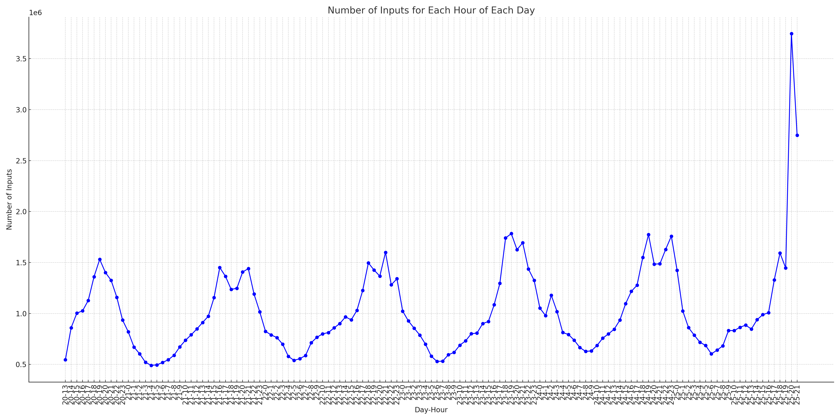
Pixel Counts by Color
Pixel Requests Hour by Hour
Similar trends throughout all days from 7-21 to 7-24 with increase from 14th to 20th hour of the day. However, 7-25 had a considerable increase at 19th hour to 20th before the deadline.
Red lines separating days.
7-20
7-21
7-22
7-23
7-24
7-25

Slide 3
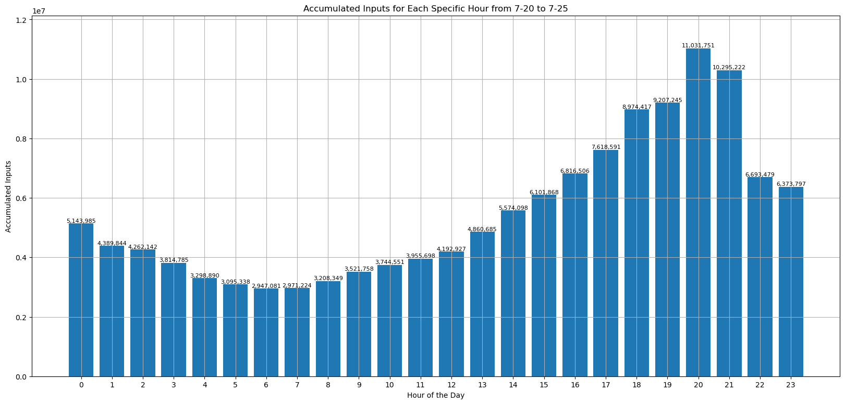
Pixel Counts by Color
Cumulative Pixel Requests per Hour
12 pm PST
An increase of requests later in the day based on the UTC timestamps (Greenwich).
12 am PST

Slide 4
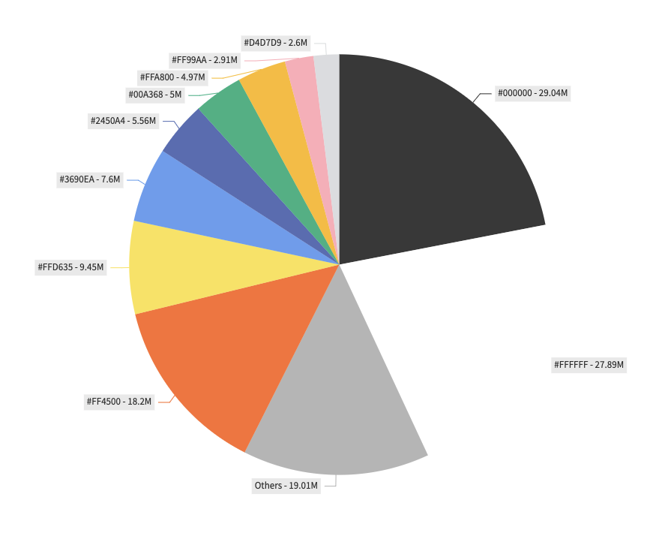
Pixel Counts by Color
Almost half of pixel inputs are black or white.

Slide 5
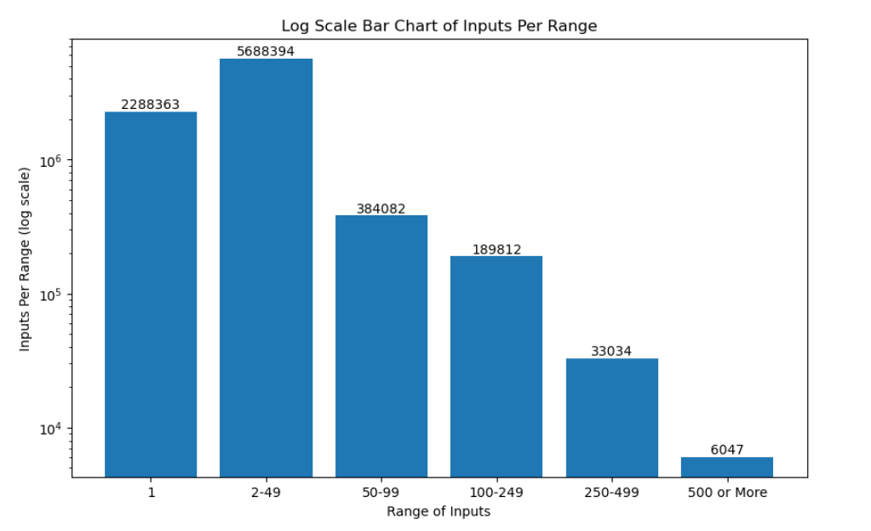
Pixel Counts by Color
Log Scale – Per Range of Inputs
Decrease in number of users in each range as inputs per user increase.

Slide 6
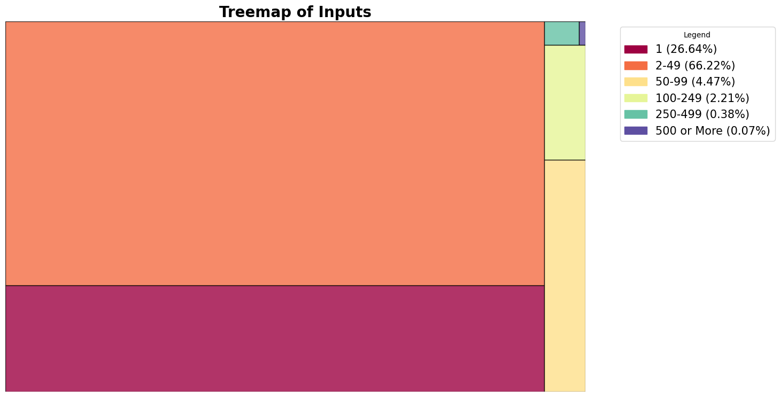
Inputs per Range
500+
250-499
100-249
2-49
Up to 92.86%
From 1-49
50-99
1

Slide 7

Bot Criteria
Humans rarely select the same exact pixel twice.
Bots select the same pixel more than once in a short span of time.
We read the data 10,000 lines at a time.
Anyone repeating the exact same post is tagged as a suspected bot.

Slide 8
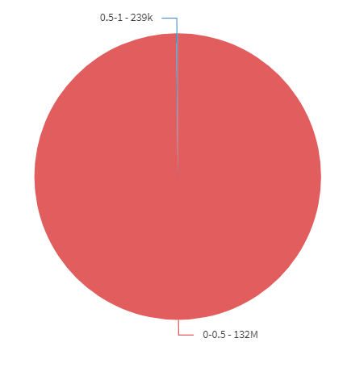
Pixel Counts by Bot Status
1 = Bots
0 = Human

Slide 9
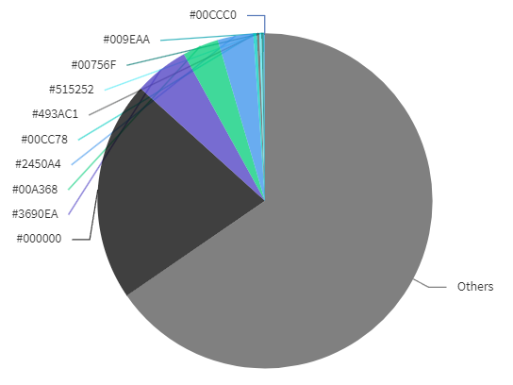
Pixel Counts by Color - Compared
For Bots Only
For Entire Dataset

Slide 10
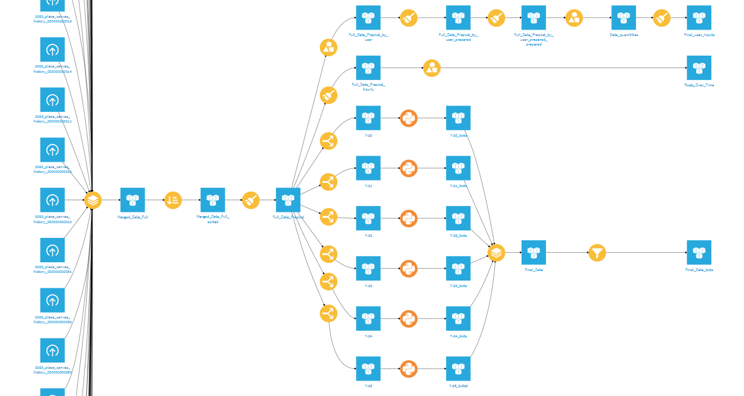
Dataiku Workflow
Range of inputs analysis line.
Inputs per hours analysis line
53 datasets merged.
Postscript data, merged.
Python scripts for bot analysis for each day.
Data for each day.

Slide 11
Thanks!

